Slide 1
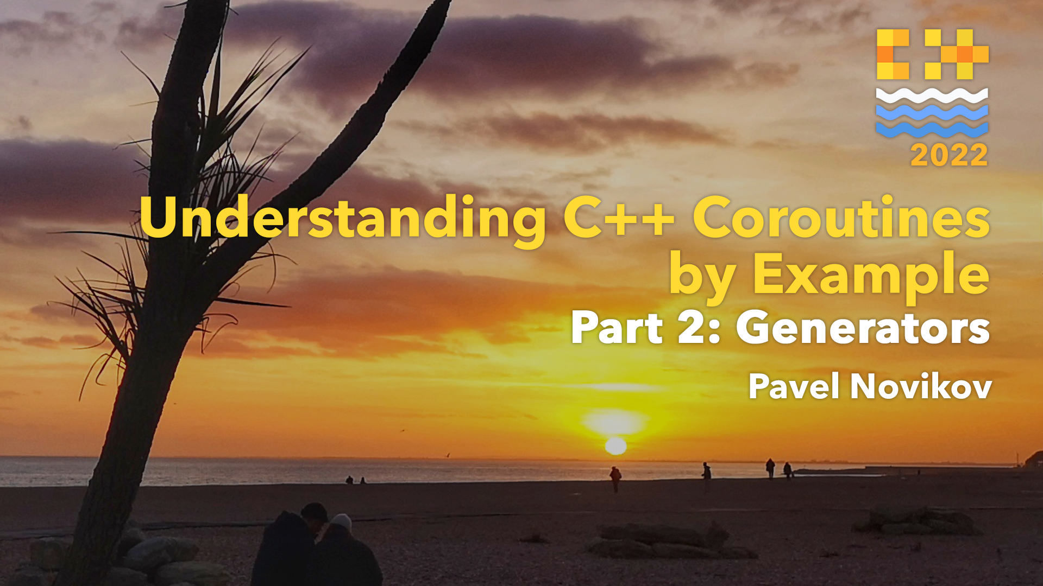

Slide 2

Understanding C++ coroutines by example part 2: generators
Pavel Novikov
@cpp_ape

Slide 3
Goals of this talk
Develop intuition about how generators work:
coroutine generators in general
range generators
+ how recursive generators work in principle
async generators
Disclaimer
Code on the slides is intended for educational purposes,
it is somewhat suboptimal and should not be used in production as it is.

Slide 4
What is a C++ coroutine?
Generator<int> foo() {
co_yield 42;
}
A function is a coroutine if it contains one of these:
co_return (coroutine return statement)
co_await (await expression)
co_yield (yield expression)

Slide 5
What is a C++ coroutine?
routine
Coroutine taxonomy
subroutine
coroutine
stackfull
(fiber)
stackless

Slide 6
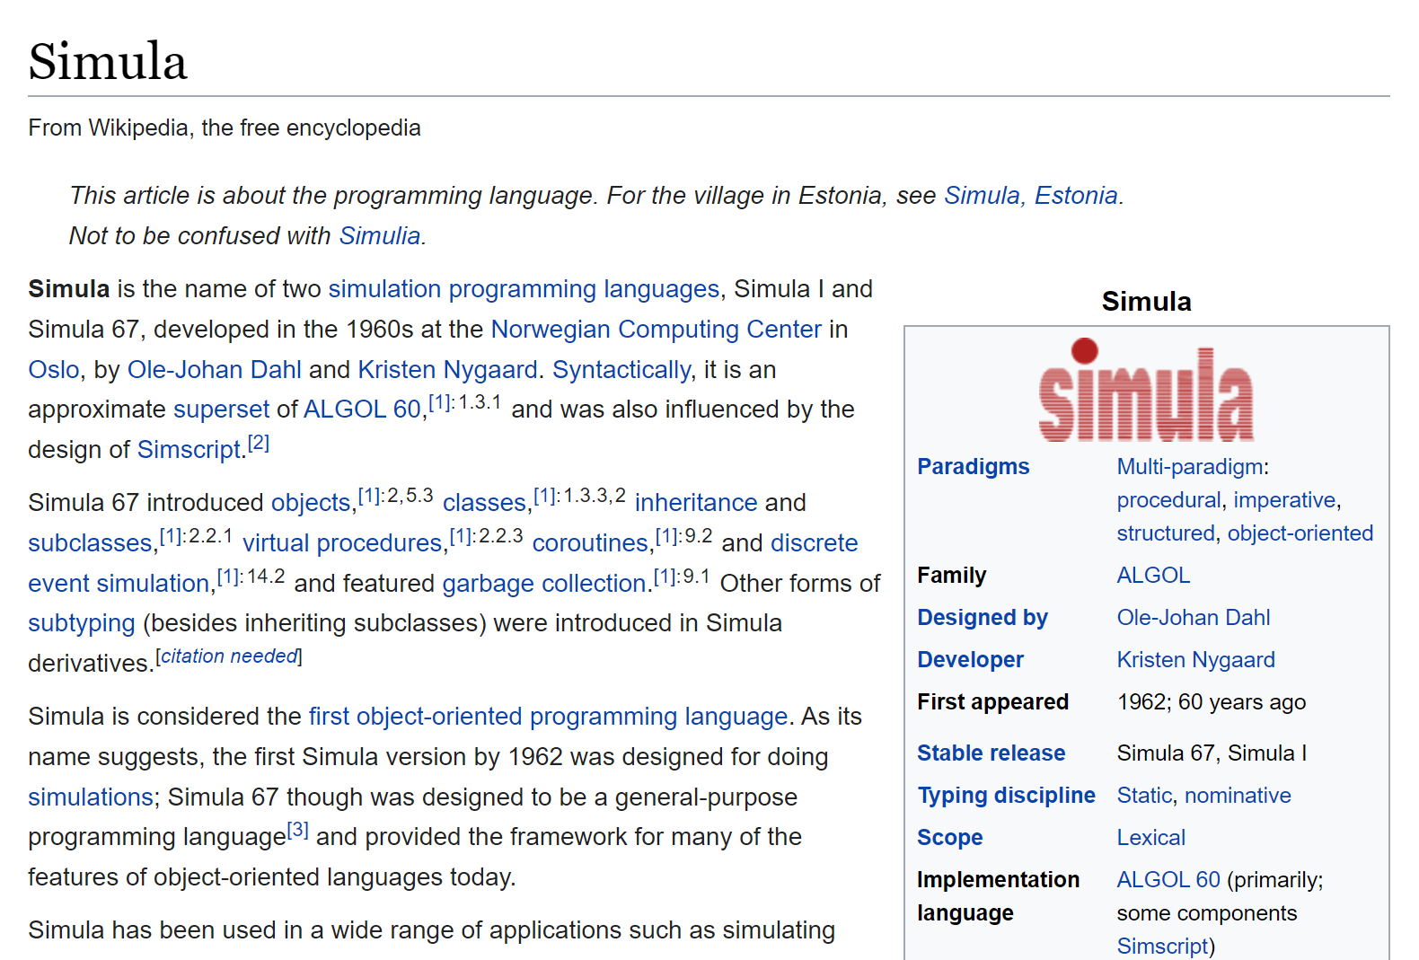
What is a C++ coroutine?

Slide 7
What is a C++ coroutine?
Generator<int> foo() {
co_yield 42;
}
A coroutine behaves as if its function-body were replaced by:
{
promise-type promise promise-constructor-arguments ;
try {
co_await promise.initial_suspend() ;
function-body
} catch ( ... ) {
if (!initial-await-resume-called)
throw ;
promise.unhandled_exception() ;
}
final-suspend :
co_await promise.final_suspend() ;
}
foo()
foo() body
initial suspend
final suspend

Slide 8

What is a C++ coroutine?
Generator<int> foo() {
co_yield 42;
}
A coroutine behaves as if its function-body were replaced by:
{
promise-type promise promise-constructor-arguments ;
try {
co_await promise.initial_suspend() ;
function-body
} catch ( ... ) {
if (!initial-await-resume-called)
throw ;
promise.unhandled_exception() ;
}
final-suspend :
co_await promise.final_suspend() ;
}
foo()
foo() body
initial suspend
final suspend

Slide 9
What is a C++ coroutine?
co_yield expression
co_­await promise.yield_­value(expression)

Slide 10
What is a C++ coroutine?
co_return expression_{opt};
{
expression_{opt};
promise.return_void();
goto final-suspend;
}
should be of type void in our case
Generator<int> foo() {
co_yield 42;
co_return;
}
Generator<int> foo() {
co_yield 42;
// implicit co_return;
}

Slide 11
Best practices so far
"Lazy" asynchronous tasks which do not start immediately, they are suspended at initial suspend point
(contrast to "eager" tasks)
Result from asynchronous tasks can be obtained either
by co_­awaiting within a coroutine (possibly suspending it), or
by synchronously waiting (possibly blocking the thread)
(unlike std::future and co.)
Watch Lewis Baker's talk
"Structured Concurrency: Writing safer concurrent code with coroutines and algorithms"

Slide 12
“Naïve” generator
suspends
coroutine frame
contains
and internal state stuff
Generator<std::string> foo() {
co_yield "hello";
const auto s = std::string{ "world" };
co_yield s;
}
const auto f = foo();
std::cout << f() << ' ' << f() << '\n';
resumes
suspends
promise
tells when and how to suspend and resume
resumes
suspends
lives until f is destroyed
outputs
hello world

Slide 13

“Naïve” generator
Why initial suspend?
Generator<int> bar() {
const auto values = getValues(); // may throw
for (auto n : values)
co_yield n;
}
{
const auto g = bar(); // created but not used
}
initial suspend
zero overhead principle

Slide 14
“Naïve” generator
Generator<std::string> foo() {
co_yield "hello";
const auto s = std::string{ "world" };
co_yield s;
}
{
const auto f = foo();
std::cout << f() << '\n';
} // f is safely destroyed
safely* destroys coroutine frame
in suspended state
and frees all associated resources
f.~Generator<std::string>()

Slide 15
“Naïve” generator
template<typename T>
struct Generator {
struct promise_type;
Generator(Generator &&other) noexcept;
Generator &operator=(Generator &&other) noexcept;
~Generator();
auto &operator()() const;
private:
explicit Generator(promise_type &promise) noexcept;
std::coroutine_handle<promise_type> coro;
};
probably should be [[nodiscard]]
only coroutine handle is stored

Slide 16
“Naïve” generator
coroutine frame
contains
and internal state stuff
struct promise_type {
auto get_return_object() noexcept;
std::suspend_always initial_suspend() const noexcept;
std::suspend_always final_suspend() const noexcept;
std::suspend_always yield_value(const T &value) noexcept(std::is_nothrow_copy_constructible_v<T>);
void return_void() const noexcept {}
void unhandled_exception() noexcept(std::is_nothrow_copy_constructible_v<std::exception_ptr>);
T &getValue();
private:
std::variant<std::monostate, T, std::exception_ptr> result;
};
promise
tells when and how to suspend and resume
mandatory

Slide 17
“Naïve” generator
auto get_return_object() noexcept {
return Generator{ *this };
}
Generator<std::string> foo();
const auto f = foo();

Slide 18
“Naïve” generator
std::suspend_always initial_suspend() const noexcept {
return {};
}
std::suspend_always final_suspend() const noexcept {
return {};
}
initial suspend
Generator<std::string> foo() {
co_yield "hello";
const auto s = std::string{ "world" };
co_yield s;
}
final suspend

Slide 19
“Naïve” generator
std::suspend_always yield_value(const T &value)
noexcept(std::is_nothrow_copy_constructible_v<T>) {
result = value;
return {};
}
co_yield expression
co_­await promise.yield_­value(expression)
Generator<std::string> foo() {
co_yield "hello";
const auto s = std::string{ "world" };
co_yield s;
}
suspends

Slide 20
“Naïve” generator
void return_void() const noexcept {}
co_return expression_{opt};
{ expression_{opt}; promise.return_void(); goto final-suspend; }
Generator<std::string> foo() {
co_yield "hello";
const auto s = std::string{ "world" };
co_yield s;
co_return;
}

Slide 21
“Naïve” generator
void unhandled_exception()
noexcept(std::is_nothrow_copy_constructible_v<std::exception_ptr>) {
result = std::current_exception();
}
{
//...
try {
//...
function-body
}
catch (...) {
//...
promise.unhandled_exception();
}
//...
}

Slide 22
“Naïve” generator
struct promise_type {
//...
T &getValue() {
if (std::holds_alternative<std::exception_ptr>(result))
std::rethrow_exception(std::get<std::exception_ptr>(result));
return std::get<T>(result);
}
private:
std::variant<std::monostate, T, std::exception_ptr> result;
};
precondition:
we must have result or exception

Slide 23
“Naïve” generator
coroutine frame
contains
and internal state stuff
struct promise_type {
auto get_return_object() noexcept;
std::suspend_always initial_suspend() const noexcept;
std::suspend_always final_suspend() const noexcept;
std::suspend_always yield_value(const T &value) noexcept(std::is_nothrow_copy_constructible_v<T>);
void return_void() const noexcept {}
void unhandled_exception() noexcept(std::is_nothrow_copy_constructible_v<std::exception_ptr>);
T &getValue();
private:
std::variant<std::monostate, T, std::exception_ptr> result;
};
promise
tells when and how to suspend and resume
mandatory

Slide 24
“Naïve” generator
template<typename T>
struct Generator {
struct promise_type;
Generator(Generator &&other) noexcept;
Generator &operator=(Generator &&other) noexcept;
~Generator();
auto &operator()() const;
private:
explicit Generator(promise_type &promise) noexcept;
std::coroutine_handle<promise_type> coro;
};
only coroutine handle is stored

Slide 25
“Naïve” generator
Generator(Generator &&other) noexcept :
coro{ std::exchange(other.coro, nullptr) }
{}
Generator &operator=(Generator &&other) noexcept {
if (coro)
coro.destroy();
coro = std::exchange(other.coro, nullptr);
}
~Generator() {
if (coro)
coro.destroy();
}

Slide 26
“Naïve” generator
auto &operator()() const {
coro(); // same as 'coro.resume()'
return coro.promise().getValue();
}
struct promise_type {
//...
T &getValue() {
if (std::holds_alternative<std::exception_ptr>(result))
std::rethrow_exception(std::get<std::exception_ptr>(result));
return std::get<T>(result);
}
private:
std::variant<std::monostate, T, std::exception_ptr> result;
};

Slide 27
“Naïve” generator
struct promise_type {
auto get_return_object() noexcept {
return Generator{ *this };
}
//...
};
template<typename T>
struct Generator {
//...
private:
explicit Generator(promise_type &promise) noexcept :
coro{ std::coroutine_handle<promise_type>::from_promise(promise) }
{}
std::coroutine_handle<promise_type> coro;
};

Slide 28
“Naïve” generator
template<typename T>
struct Generator {
struct promise_type;
Generator(Generator &&other) noexcept;
Generator &operator=(Generator &&other) noexcept;
~Generator();
auto &operator()() const;
private:
explicit Generator(promise_type &promise) noexcept;
std::coroutine_handle<promise_type> coro;
};
only coroutine handle is stored

Slide 29
“Naïve” generator
suspends
coroutine frame
contains
and internal state stuff
Generator<std::string> foo() {
co_yield "hello";
const auto s = std::string{ "world" };
co_yield s;
}
const auto f = foo();
std::cout << f() << ' '
<< f() << '\n';
resumes
suspends
promise
tells when and how to suspend and resume
std::suspend_always yield_value(const T &value)
noexcept(std::is_nothrow_copy_constructible_v<T>) {
result = value;
return {};
}
auto &Generator::operator()() const {
coro(); // same as 'coro.resume()'
return coro.promise().getValue();
}
std::suspend_always initial_suspend() const noexcept {
return {};
}
auto get_return_object() noexcept {
return Generator{ *this };
}
T &getValue() {
if (std::holds_alternative<std::exception_ptr>(result))
std::rethrow_exception(std::get<std::exception_ptr>(result));
return std::get<T>(result);
}

Slide 30
“Naïve” generator
coroutine frame
contains
and internal state stuff
Generator<std::string> foo() {
co_yield "hello";
const auto s = std::string{ "world" };
co_yield s;
}
const auto f = foo();
std::cout << f() << ' '
<< f() << '\n';
promise
tells when and how to suspend and resume
resumes
suspends

Slide 31
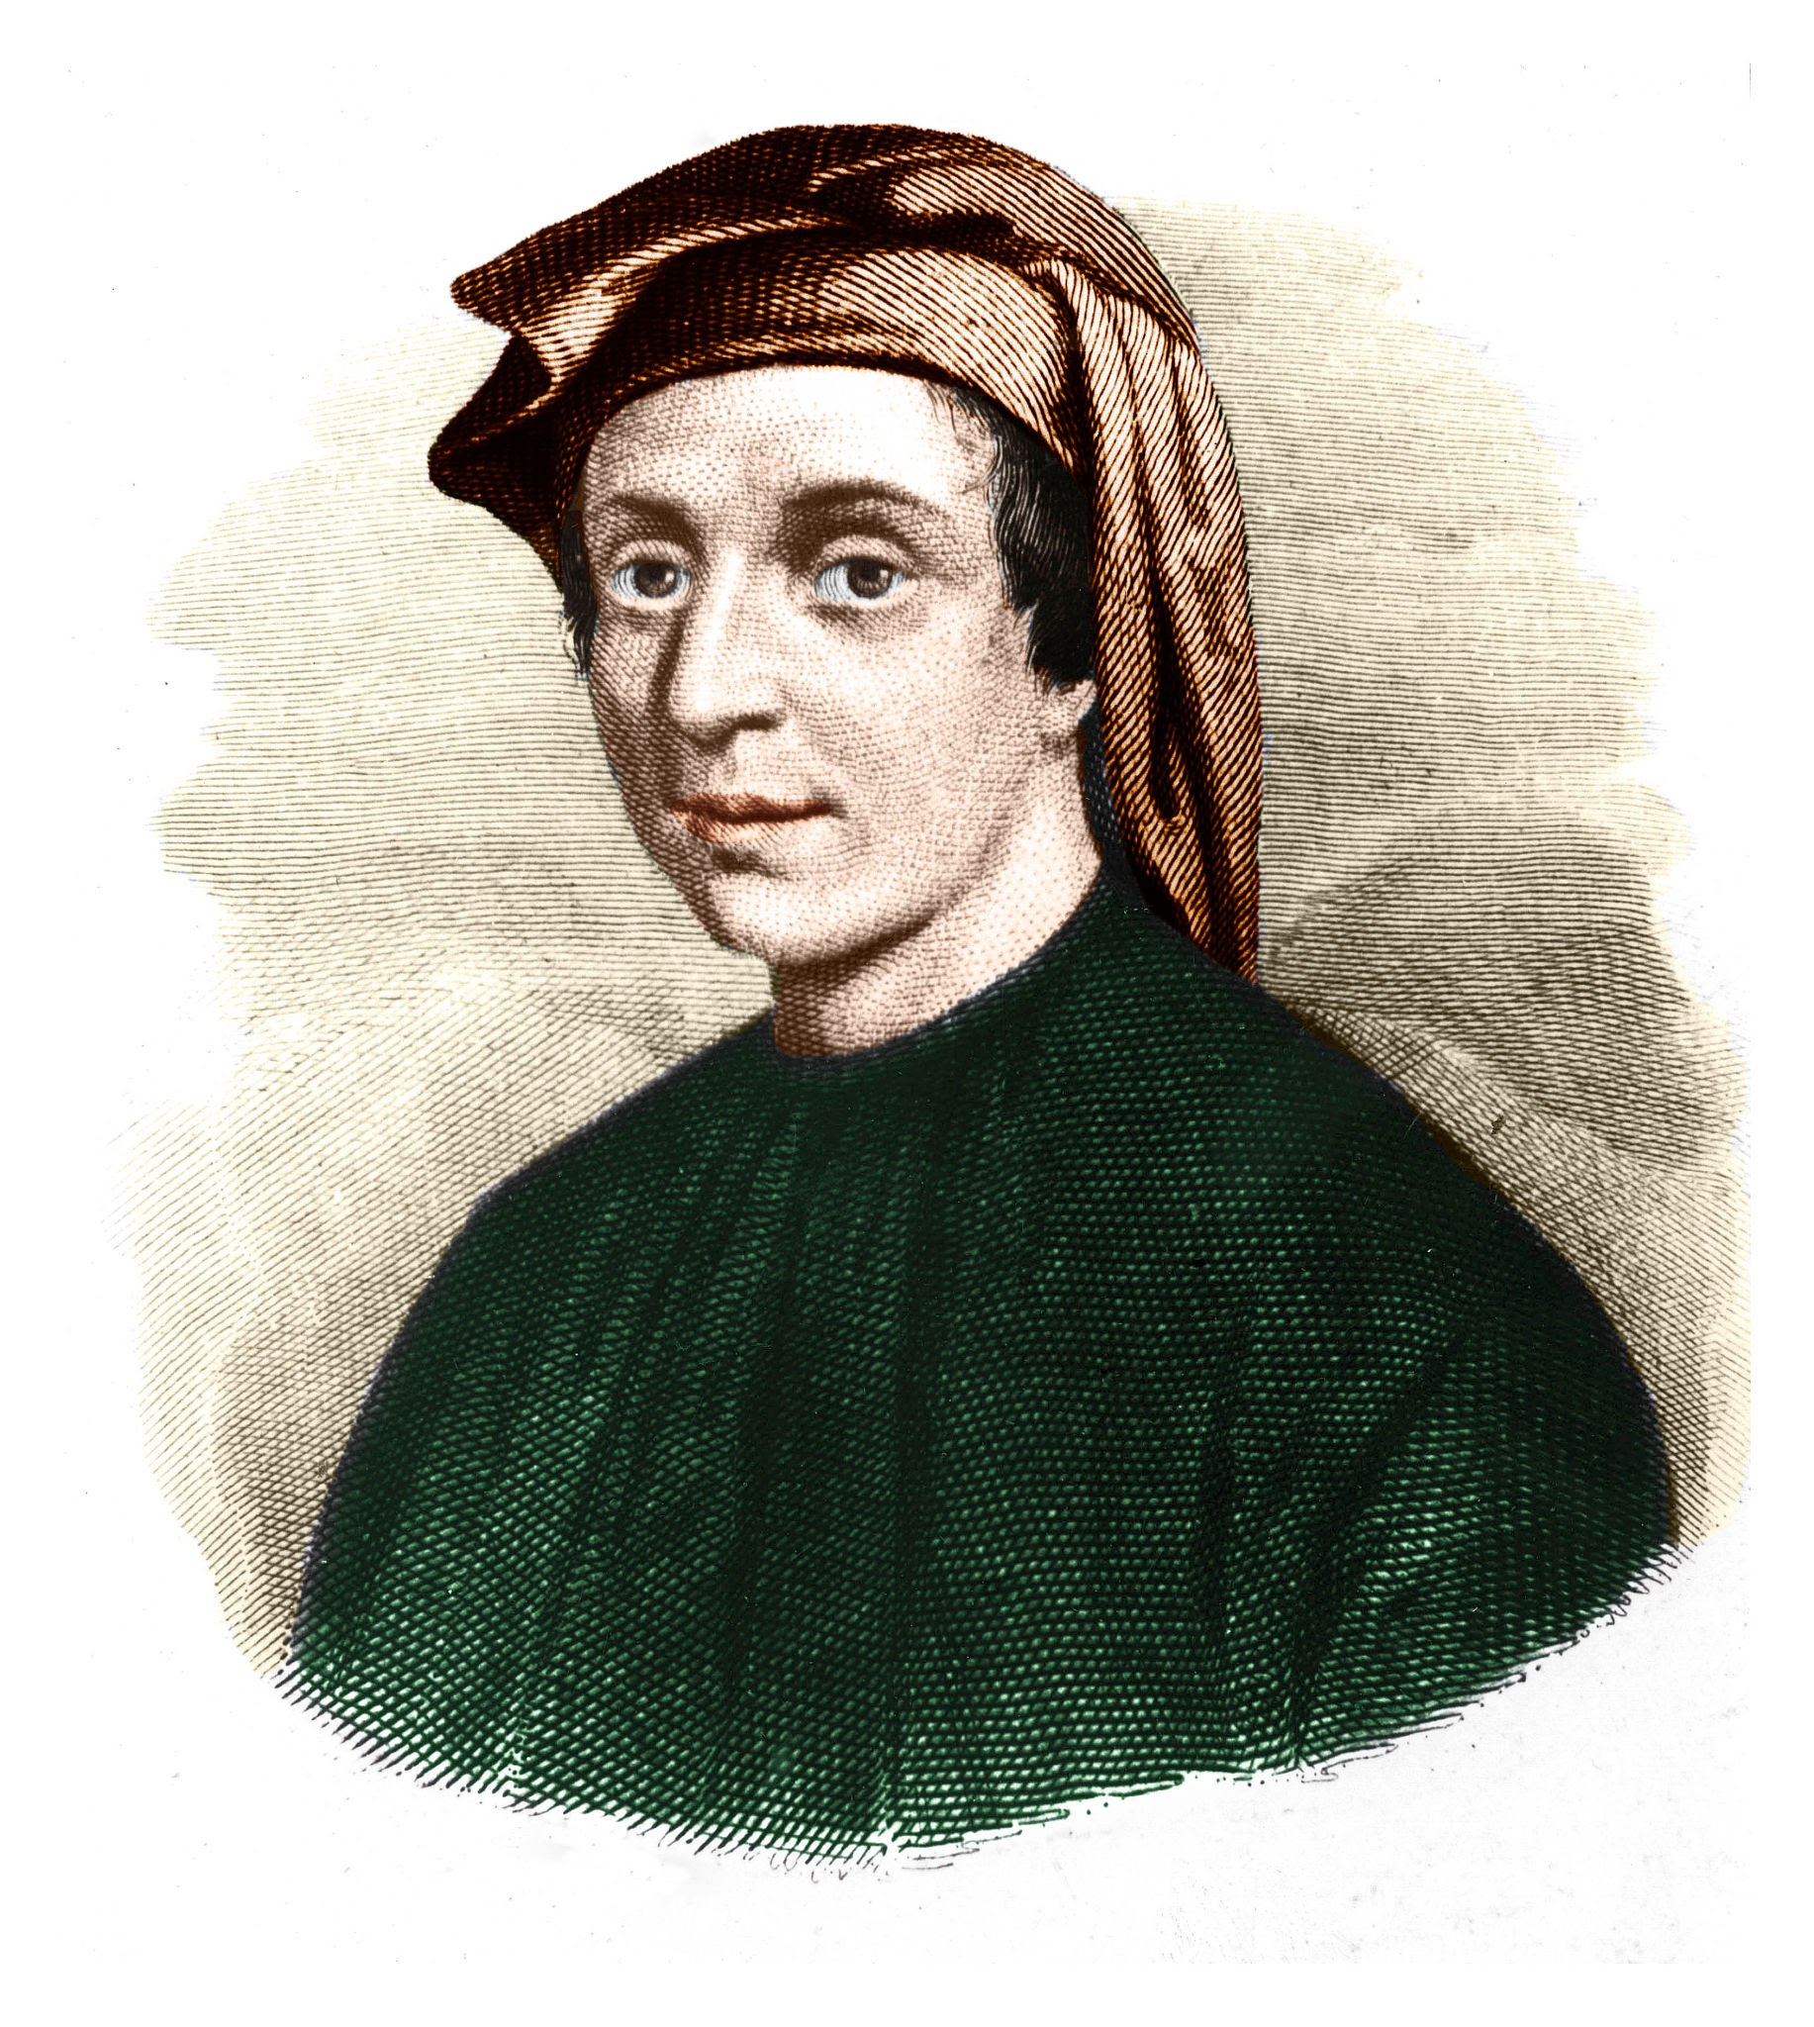
“Naïve” generator
can’t know if there are more values
perfect for infinite sequences though
Generator<int> fibonacci() {
int prev = 1, next = 1;
for (;;) {
co_yield next;
std::swap(prev, next);
next += prev;
}
}
const auto f = fibonacci();
for (size_t i = 0; i != 5; ++i)
std::cout << f() << '\n';

Slide 32
“Naïve” generator
Generator<std::string> foo() {
co_yield "hello";
const auto s = std::string{ "world" };
co_yield s;
}
const auto f = foo();
std::cout << f() << ' ' // yields "hello"
<< f() << '\n'; // yields "world"
std::cout << f(); // ???

Slide 33
“Naïve” generator
unnecessary extra copy
Generator<std::string> foo() {
co_yield "hello";
//...
}
T = std::string
std::suspend_always yield_value(const T &value)
noexcept(std::is_nothrow_copy_constructible_v<T>) {
result = value;
return {};
}
copies value into result

Slide 34
“Naïve” generator
const auto s = std::string{ "world" };
co_yield s;
co_­await promise.yield_­value(s);
suspends
variable is still accessible
during suspension

Slide 35
“Naïve” generator
co_yield "hello";
co_­await promise.yield_­value("hello");
std::string t{ "hello" }
t
suspends
t.~std::string()
resumes
std::suspend_always yield_value(const T &value)
noexcept(std::is_nothrow_copy_constructible_v<T>) {
result = value;
return {};
}
reference is valid during suspension
(until destruction of coroutine frame)

Slide 36
“Naïve” generator
At this point you know almost everything you need to know about how generators work.
The rest is just interface design and making design decisions.

Slide 37
Simple generator
const auto g = bar();
while (g.hasValue())
std::cout << g() << '\n';

Slide 38
Simple generator
template<typename T>
struct Generator {
struct promise_type;
Generator(Generator &&other) noexcept;
Generator &operator=(Generator &&other) noexcept;
~Generator();
bool hasValue() const noexcept; //has value or exception
auto &operator()() const;
private:
explicit Generator(promise_type &promise) noexcept;
void getNextValue() const noexcept;
std::coroutine_handle<promise_type> coro;
mutable bool gotValue = false;
};

Slide 39
Simple generator
const auto g = bar();
std::cout << g() << '\n'; // we _know_ it has a value
compared to
if (g.hasValue())
std::cout << g() << '\n';
has to get the next value

Slide 40
Simple generator
const auto g = bar();
while (g.hasValue())
std::cout << g() << '\n';
UGLY

Slide 41
Simple generator
template<typename T>
struct Generator {
struct promise_type;
Generator(Generator &&other) noexcept;
Generator &operator=(Generator &&other) noexcept;
~Generator();
bool advance() const noexcept;
auto &getValue() const;
private:
explicit Generator(promise_type &promise) noexcept;
std::coroutine_handle<promise_type> coro;
};

Slide 42
Simple generator
const auto g = bar();
while (g.advance())
std::cout << g.getValue() << '\n';

Slide 43
Simple generator
template<typename T>
struct Generator {
struct promise_type;
Generator(Generator &&other) noexcept;
Generator &operator=(Generator &&other) noexcept;
~Generator();
bool advance() const noexcept;
auto &getValue() const;
private:
explicit Generator(promise_type &promise) noexcept;
std::coroutine_handle<promise_type> coro;
};

Slide 44
Simple generator
struct promise_type {
auto get_return_object() noexcept;
std::suspend_always initial_suspend() const noexcept;
std::suspend_always final_suspend() const noexcept;
std::suspend_always yield_value(const T &value) noexcept(std::is_nothrow_copy_constructible_v<T>);
void return_void() const noexcept {}
void unhandled_exception() noexcept(std::is_nothrow_copy_constructible_v<std::exception_ptr>);
bool hasException() const noexcept;
T &getValue();
private:
std::variant<std::monostate, T, std::exception_ptr> result;
};

Slide 45
Simple generator
struct promise_type {
//...
std::suspend_always yield_value(const T &value)
noexcept(std::is_nothrow_copy_constructible_v<T>) {
result = value;
return {};
}
//...
private:
std::variant<std::monostate, T, std::exception_ptr> result;
};
copies value into result

Slide 46
Simple generator
struct promise_type {
//...
std::suspend_always yield_value(const T &value)
noexcept(std::is_nothrow_copy_constructible_v<T>) {
result = value;
return {};
}
std::suspend_always yield_value(T &&value) noexcept {
result = std::addressof(value);
return {};
}
//...
private:
std::variant<std::monostate, T, T*, std::exception_ptr> result;
};
copies value into result

Slide 47
Simple generator
struct promise_type {
//...
bool hasException() const noexcept {
return std::holds_alternative<std::exception_ptr>(result);
}
T &getValue() {
if (hasException())
std::rethrow_exception(std::get<std::exception_ptr>(result));
return std::holds_alternative<T>(result) ? std::get<T>(result) :
*std::get<T*>(result);
}
//...
private:
std::variant<std::monostate, T, T*, std::exception_ptr> result;
};
precondition:
we must have result or exception

Slide 48
Simple generator
const auto f = foo();
std::vector<std::string> values;
while (f.advance())
values.push_back(std::move(f.getValue());
What if we want to yield values only by const reference?
value is returned by non-const reference
and can be moved from

Slide 49
struct promise_type {
//...
std::suspend_always yield_value(const T &value) noexcept {
result = std::addressof(value);
return {};
}
//...
const T &getValue() {
if (hasException())
std::rethrow_exception(std::get<std::exception_ptr>(result));
return *std::get<const T*>(result);
}
//...
private:
std::variant<std::monostate, const T*, std::exception_ptr> result;
};
template<typename T>
struct Generator<const T> {
struct promise_type;
//...
auto &getValue() const;
//...
};

Slide 50
Simple generator
struct promise_type {
auto get_return_object() noexcept;
std::suspend_always initial_suspend() const noexcept;
std::suspend_always final_suspend() const noexcept;
std::suspend_always yield_value(const T &value) noexcept(std::is_nothrow_copy_constructible_v<T>);
std::suspend_always yield_value(T &&value) noexcept;
void return_void() const noexcept {}
void unhandled_exception() noexcept(std::is_nothrow_copy_constructible_v<std::exception_ptr>);
bool hasException() const noexcept;
T &getValue();
private:
std::variant<std::monostate, T, T*, std::exception_ptr> result;
};

Slide 51
Simple generator
template<typename T>
struct Generator {
struct promise_type;
Generator(Generator &&other) noexcept;
Generator &operator=(Generator &&other) noexcept;
~Generator();
bool advance() const noexcept;
auto &getValue() const;
private:
explicit Generator(promise_type &promise) noexcept;
std::coroutine_handle<promise_type> coro;
};

Slide 52
Simple generator
template<typename T>
struct Generator {
//...
bool advance() const noexcept {
coro();
return !coro.done() || coro.promise().hasException();
}
auto &getValue() const {
return coro.promise().getValue();
}
//...
};
precondition:
advance() must be called and
return true

Slide 53
Simple generator
Generator<int> bar() {
const auto values = getValues(); // may throw
for (auto n : values)
co_yield n;
}
const auto g = bar();
try {
while (g.advance())
std::cout << g.getValue() << '\n';
}
catch (const std::exception &e) {
std::cout << "exception: " << e.what() << '\n';
}
may throw exception
from within the coroutine

Slide 54
Simple generator
const auto g = bar();
//...
try {
if (g.advance()) // has exception, not value
std::cout << g.getValue() << '\n'; // throws
}
catch (const std::exception &e) {
std::cout << "exception: " << e.what() << '\n';
}
std::cout << g.getValue() << '\n'; // still has exception
// and throws

Slide 55
Simple generator
template<typename T>
struct Generator {
struct promise_type;
Generator(Generator &&other) noexcept;
Generator &operator=(Generator &&other) noexcept;
~Generator();
bool advance() const noexcept;
auto &getValue() const;
bool hasException() const noexcept;
private:
explicit Generator(promise_type &promise) noexcept;
std::coroutine_handle<promise_type> coro;
};
bool hasException() const noexcept {
return coro.promise().hasException();
}

Slide 56
Simple generator
const auto g = bar();
while (g.advance()) {
if (g.hasException()) {
// handle exception
}
std::cout << g.getValue() << '\n';
}
UGLY

Slide 57
What we want to have
Required operations:
Iterators and ranges:
check if there are values
get a value
advance to the next value
auto i = r.begin()
if (i != r.end()) { // check
auto x = *i; // get
++i; // advance
}

Slide 58
What we want to have
const auto f = foo();
auto i = f.begin();
std::cout << *i << ' ' << *(++i) << '\n';
const auto g = bar();
for (auto &i : g)
std::cout << i << '\n';

Slide 59
Range generator
template<typename T>
struct Generator {
struct promise_type;
struct Iterator;
Generator(Generator &&other) noexcept;
Generator &operator=(Generator &&other) noexcept;
~Generator();
Iterator begin() const;
Iterator end() const noexcept;
private:
explicit Generator(promise_type &promise) noexcept;
std::coroutine_handle<promise_type> coro;
};

Slide 60
struct promise_type {
auto get_return_object() noexcept;
std::suspend_always initial_suspend() const noexcept;
std::suspend_always final_suspend() const noexcept;
std::suspend_always yield_value(const T &value)
noexcept(std::is_nothrow_copy_constructible_v<T>);
std::suspend_always yield_value(T &&value) noexcept;
void return_void() const noexcept {}
void unhandled_exception()
noexcept(std::is_nothrow_copy_constructible_v<std::exception_ptr>);
bool isValueInitialized() const noexcept;
T &getValue() noexcept;
bool hasException() const noexcept;
void throwIfException() const;
private:
std::variant<std::monostate, T, T*, std::exception_ptr> result;
};

Slide 61
struct promise_type {
//...
bool isValueInitialized() const noexcept {
return !std::holds_alternative<std::monostate>(result);
}
T &getValue() noexcept {
return std::holds_alternative<T>(result) ? std::get<T>(result) :
*std::get<T*>(result);
}
bool hasException() const noexcept {
return std::holds_alternative<std::exception_ptr>(result);
}
void throwIfException() const {
if (hasException())
std::rethrow_exception(std::get<std::exception_ptr>(result));
}
//...
};

Slide 62
Range generator
struct Iterator {
// iterator boilerplate
Iterator() noexcept = default;
explicit Iterator(const std::coroutine_handle<promise_type> &coro) noexcept;
friend bool operator==(const Iterator&, const Iterator&) noexcept = default;
friend bool operator!=(const Iterator&, const Iterator&) noexcept = default;
Iterator &operator++();
auto &operator*() const noexcept;
private:
const std::coroutine_handle<promise_type> *coro = nullptr;
};

Slide 63
Range generator
struct Iterator {
using iterator_category = std::input_iterator_tag;
using difference_type = std::ptrdiff_t; // doesn't make sense for input iterator
using value_type = T;
using reference = T&;
using pointer = T*;
Iterator() noexcept = default;
explicit Iterator(const std::coroutine_handle<promise_type> &coro) noexcept :
coro{ &coro }
{}
friend bool operator==(const Iterator&, const Iterator&) noexcept = default;
friend bool operator!=(const Iterator&, const Iterator&) noexcept = default;
//...
};

Slide 64
Range generator
precondition:
can increment
++i
only if
i != end()
and coroutine is not finished
struct Iterator {
//...
Iterator &operator++() {
assert(coro != nullptr);
assert(!coro->done());
coro->resume();
if (coro->done()) {
auto coroHandle = std::exchange(coro, nullptr);
coroHandle->promise().throwIfException();
}
return *this;
}
//...
};

Slide 65
Range generator
const auto g = bar();
auto k = g.begin();
auto i = k; // 'i' and 'k' both refer to 'g.begin()'
while (i != g.end())
++i;
assert(i == g.end());
// 'k' is invalid
Iterators are invalidated when generator coroutine finishes.
(Except the end() sentinel iterator.)

Slide 66
Range generator
struct Iterator {
//...
auto &operator*() const noexcept {
assert(coro != nullptr);
assert(!coro->done());
return coro->promise().getValue();
}
private:
const std::coroutine_handle<promise_type> *coro = nullptr;
};

Slide 67
Range generator
template<typename T>
struct Generator {
struct promise_type;
struct Iterator;
Generator(Generator &&other) noexcept;
Generator &operator=(Generator &&other) noexcept;
~Generator();
Iterator begin() const;
Iterator end() const noexcept;
private:
explicit Generator(promise_type &promise) noexcept;
std::coroutine_handle<promise_type> coro;
};

Slide 68
Range generator
const auto g = bar();
if (g.begin() == g.end())
//...
for (auto &i : g) // 'g.begin()' called
std::cout << i << '\n';
Iterator begin() const {
if (coro.done())
return end();
auto i = Iterator{ coro };
if (!coro.promise().isValueInitialized())
++i; // can throw, or become '*this == end()'
return i;
}
Iterator end() const noexcept {
return {};
}

Slide 69
Range generator
template<typename T>
struct Generator {
struct promise_type;
struct Iterator;
Generator(Generator &&other) noexcept;
Generator &operator=(Generator &&other) noexcept;
~Generator();
Iterator begin() const;
Iterator end() const noexcept;
private:
explicit Generator(promise_type &promise) noexcept;
std::coroutine_handle<promise_type> coro;
};

Slide 70
Range generator
Generator<int> bar() {
const auto values = getValues(); // may throw
for (auto n : values)
co_yield n;
}

Slide 71
Range generator
const auto g = bar();
try {
for (auto &i : g)
std::cout << i << '\n';
}
catch (const std::exception &e) {
std::cout << "exception: " << e.what() << '\n';
}

Slide 72
Range generator
Generator<int> bar() {
const auto values = getValues(); // may throw
for (auto n : values)
co_yield n;
}
const auto g = bar();
for (auto &i : g)
std::cout << i << '\n';
final suspend
{
promise.return_void();
goto final-suspend;
}
co_return;
struct promise_type {
//...
std::suspend_always final_suspend() const noexcept;
//...
};

Slide 73
Range generator
Generator<int> bar() {
const auto values = getValues(); // throws
for (auto n : values)
co_yield n;
}
const auto g = bar();
for (auto &i : g)
std::cout << i << '\n';
{
//...
try {
//...
function-body
}
catch (...) {
//...
promise.unhandled_exception();
}
final-suspend:
//...
}
final suspend
struct promise_type {
//...
std::suspend_always final_suspend() const noexcept;
//...
};
g.begin() or ++it
rethrow the exception

Slide 74
Range generator
At this point you know almost everything you need to know about how generators work.
For real this time.

Slide 75
Range generator
const auto g = bar();
for (auto i = g.begin(); // may throw
i != g.end();
++i) { // may throw
std::cout <<
*i // never throws
<< '\n';
}

Slide 76
struct LazyIterator {
// iterator boilerplate
LazyIterator() noexcept = default;
explicit LazyIterator(const std::coroutine_handle<promise_type> &coro) noexcept;
friend bool operator==(const LazyIterator&, const LazyIterator&) noexcept = default;
friend bool operator!=(const LazyIterator&, const LazyIterator&) noexcept = default;
LazyIterator &operator++() noexcept;
auto &operator*() const;
friend bool hasException(const LazyIterator &i) noexcept;
private:
const std::coroutine_handle<promise_type> *coro = nullptr;
};

Slide 77
Range generator
template<typename T>
struct Generator {
struct promise_type;
struct LazyIterator;
Generator(Generator &&other) noexcept;
Generator &operator=(Generator &&other) noexcept;
~Generator();
LazyIterator begin() const noexcept;
LazyIterator end() const noexcept;
private:
explicit Generator(promise_type &promise) noexcept;
std::coroutine_handle<promise_type> coro;
};
does not throw

Slide 78
Range generator
const auto g = bar();
for (auto i = g.begin(); // does
i != g.end(); // not
++i) { // throw
if (hasException(i))
break;
std::cout << *i << '\n';
}

Slide 79
const auto g = bar();
for (auto i = g.begin(); i != g.end(); ++i) {
if (hasException(i)) {
try {
*i; // throws
}
catch (...) {
}
try {
*i; // throws
}
catch (...) {
}
break;
}
std::cout << *i << '\n';
}

Slide 80
Yielding from nested generators
Generator<int> bar() {
const auto values = getValues(); // may throw
for (auto n : values)
co_yield n;
}
Generator<int> baz() {
co_yield 1;
co_yield 2;
co_yield 3;
for (auto n : bar()) // 'bar()' is resumed and suspended
co_yield n; // yields and suspends, then resumes
}

Slide 81

Yielding from nested generators
Generator<int> qux() {
const auto g = baz();
if (auto i = g.begin(); i != g.end()) {
co_yield *i * 33;
++i;
}
for (auto i : g)
co_yield i; // yield the rest
}
up to three resumes & suspends
per yielded value!
const auto h = qux();
for (auto &i : h)
std::cout << i << '\n';

Slide 82
Recursive generator
RecursiveGenerator<int> bar() {
for (auto n : getValues())
co_yield n;
}
RecursiveGenerator<int> baz() {
co_yield 1;
co_yield 2;
co_yield 3;
co_yield bar(); // yield the _whole_ thing
}

Slide 83
Recursive generator
RecursiveGenerator<int> qux() {
const auto g = baz();
if (auto i = g.begin(); i != g.end()) {
co_yield *i * 33;
++i;
}
co_yield g; // yield the rest
}

Slide 84
const auto h = qux();
for (auto &i : h)
std::cout << i << '\n';
qux
promise
result
root
extra fields to track nested-ness
continuation

Slide 85
RecursiveGenerator<int> qux() {
const auto g = baz();
if (auto i = g.begin(); i != g.end()) {
co_yield *i * 33;
++i;
}
co_yield g; // yield the rest
}
qux
baz
promise
promise
result
result
root
root
continuation
continuation

Slide 86
RecursiveGenerator<int> baz() {
co_yield 1;
co_yield 2;
co_yield 3;
co_yield bar(); // yield the _whole_ thing
}
qux
baz
promise
promise
result
result
root
root
continuation
continuation

Slide 87
RecursiveGenerator<int> qux() {
const auto g = baz();
if (auto i = g.begin(); i != g.end()) {
co_yield *i * 33;
++i;
}
co_yield g; // yield the rest
}
qux
baz
promise
promise
result
result
root
root
continuation
continuation

Slide 88
const auto h = qux();
for (auto &i : h)
std::cout << i << '\n';
qux
baz
promise
promise
result
result
root
root
continuation
continuation

Slide 89
RecursiveGenerator<int> qux() {
const auto g = baz();
if (auto i = g.begin(); i != g.end()) {
co_yield *i * 33;
++i;
}
co_yield g; // yield the rest
}
qux
baz
promise
promise
result
result
root
root
continuation
continuation

Slide 90
RecursiveGenerator<int> baz() {
co_yield 1;
co_yield 2;
co_yield 3;
co_yield bar(); // yield the _whole_ thing
}
qux
baz
promise
promise
result
result
root
root
continuation
continuation

Slide 91
const auto h = qux();
for (auto &i : h)
std::cout << i << '\n';
qux
baz
promise
promise
result
result
root
root
continuation
continuation

Slide 92
RecursiveGenerator<int> baz() {
co_yield 1;
co_yield 2;
co_yield 3;
co_yield bar(); // yield the _whole_ thing
}
bar
promise
result
root
continuation
qux
baz
promise
promise
result
result
root
root
continuation
continuation

Slide 93
const auto h = qux();
for (auto &i : h)
std::cout << i << '\n';
bar
promise
result
root
continuation
qux
baz
promise
promise
result
result
root
root
continuation
continuation

Slide 94
RecursiveGenerator<int> bar() {
for (auto n : getValues())
co_yield n;
}
bar
promise
result
root
continuation
qux
baz
promise
promise
result
result
root
root
continuation
continuation

Slide 95
RecursiveGenerator<int> baz() {
co_yield 1;
co_yield 2;
co_yield 3;
co_yield bar(); // yield the _whole_ thing
}
bar
promise
result
root
continuation
qux
baz
promise
promise
result
result
root
root
continuation
continuation

Slide 96
RecursiveGenerator<int> qux() {
const auto g = baz();
if (auto i = g.begin(); i != g.end()) {
co_yield *i * 33;
++i;
}
co_yield g; // yield the rest
}
qux
baz
promise
promise
result
result
root
root
continuation
continuation

Slide 97
const auto h = qux();
for (auto &i : h)
std::cout << i << '\n';
qux
promise
result
root
continuation

Slide 98
Recursive generator
In this presentation Generator and RecursiveGenerator are different because the latter needs additional fields to track nested-ness, which is an overhead (though a reasonably small one).

Slide 99
std::generator
P2502: std::generator: Synchronous Coroutine Generator for Ranges by Casey Carter http://wg21.link/p2502
accepted into C++23
works very much like RecursiveGenerator

Slide 100
namespace std {
template<class R, class V = void, class Allocator = void>
class generator {
public:
using yielded =
conditional_t<is_reference_v<reference>, reference, const reference&>;
class promise_type;
generator(const generator&) = delete;
generator(generator&&) noexcept;
~generator();
generator &operator=(const generator&) = delete;
generator &operator=(generator&&) noexcept;
iterator begin();
default_sentinel_t end() const noexcept;
};
template<class R, class V, class Allocator>
constexpr bool ranges::enable_view<generator<R, V, Allocator>> = true;
}
[[nodiscard]]?

Slide 101
std::generator
Members [generator.members]
iterator begin();
Preconditions: coroutine_ refers to a coroutine suspended at its initial suspend-point.
Effects: Equivalent to:
coroutine_.resume();
return iterator(coroutine_);
Remarks: This function pushes coroutine_ onto the generator’s empty stack of associated coroutines.
[ Note: A program that calls begin more than once on the same generator has undefined behavior. — end note ]

Slide 102
std::generator
std::generator<int> qux() {
const auto g = baz();
if (auto i = g.begin(); i != g.end()) {
co_yield *i * 33;
++i;
}
for (auto i : g) // UB: 'g.begin()' is called
co_yield i; // yield the rest
}
changes observable state
(that we can't observe)

Slide 103
std::generator
std::generator<int> qux() {
const auto g = baz();
for (auto &i : g | std::views::take(1))
co_yield i * 33;
for (auto i : g) // UB: 'g.begin()' is called
co_yield i; // yield the rest
}

Slide 104
std::generator
std::generator<int> qux() {
const auto g = baz();
for (auto &i : g | std::views::take(1))
co_yield i * 33;
co_yield std::ranges::elements_of{ g }; // UB?
}

Slide 105
std::generator
std::generator<int> qux() {
auto g = baz();
for (auto &i : g | std::views::take(1))
co_yield i * 33;
// pointless: calling 'begin()' is UB
processValues(std::move(g));
}

Slide 106
std::generator
std::istringstream s{ "hello world ..." };
for (auto i = std::istream_iterator<std::string>{ s };
i != std::istream_iterator<std::string>{};
++i) {
std::cout << *i << '\n';
//...
if (someCondition)
break;
}
for (auto i = std::istream_iterator<std::string>{ s };
i != std::istream_iterator<std::string>{};
++i) {
// do something else with the rest of the data
}
istream_iterator's ctor reads from s, i.e. changes its observable state
iteration can be safely restarted/continued

Slide 107
std::generator
generator type in the standard library
Yay!
recursive — always has (reasonably small) overhead when you don't yield nested generators
whatever…
can't restart/continue iteration after begin() is already called once
(╯°□°）╯︵ ┻━┻

Slide 108
Async generator
Task<std::vector<int>> getValuesAsync();
AsyncGenerator<int> generateValuesAsync() {
const auto values = co_await getValuesAsync();
for (auto &v : values) {
if (isValueValid(v))
co_yield v;
}
}

Slide 109
Async generator
Task<int> getPrettiestValue() {
auto g = generateValuesAsync();
//...
for (auto i = g.begin();
i != g.end();
i = co_await i.next()) {
//...
}
//...
}

Slide 110
Async generator
Task<int> getPrettiestValue() {
auto g = generateValuesAsync();
int prettiest = -37;
int prettinessLevel = 0;
while (auto next = co_await g.next()) {
const auto p = getPrettinessLevel(*next);
if (prettinessLevel < p ||
prettinessLevel == p && prettiest < *next) {
prettiest = *next;
prettinessLevel = p;
}
}
co_return prettiest;
}

Slide 111
Async generator
try {
const auto value = syncWait(getPrettiestValue());
std::cout << value << '\n';
}
catch (const std::exception &e) {
std::cout << "exception: " << e.what() << '\n';
}

Slide 112
Async generator
Task<int> getPrettiestValue() {
auto g = generateValuesAsync();
//...
while (auto next = co_await g.next()) {
//...
}
//...
}
this coroutine is resumed
as a continuation of g
and optional result is returned
this coroutine is suspended
and set as continuation for g

Slide 113
Async generator
What lies ahead
is separated by an even thinner veil
from nonsense.

Slide 114
Async generator
template<typename T>
struct AsyncGenerator {
struct promise_type;
AsyncGenerator(AsyncGenerator &&other) noexcept;
AsyncGenerator &operator=(AsyncGenerator &&other) noexcept;
~AsyncGenerator();
auto next();
private:
explicit AsyncGenerator(promise_type &promise) noexcept;
std::coroutine_handle<promise_type> coro;
};

Slide 115
Async generator
template<typename T>
struct AsyncGenerator {
//...
AsyncGenerator(AsyncGenerator &&other) noexcept :
coro{ std::exchange(other.coro, nullptr) }
{}
AsyncGenerator &operator=(AsyncGenerator &&other) noexcept {
if (coro)
coro.destroy();
coro = std::exchange(other.coro, nullptr);
}
~AsyncGenerator() {
if (coro)
coro.destroy();
}
//...
};

Slide 116
Async generator
template<typename T>
struct AsyncGenerator {
//...
auto next() {
return typename promise_type::NextAwaitable{ coro };
}
private:
explicit AsyncGenerator(promise_type &promise) noexcept :
coro{ std::coroutine_handle<promise_type>::from_promise(promise) }
{}
std::coroutine_handle<promise_type> coro;
};

Slide 117
struct promise_type {
auto get_return_object() noexcept;
std::suspend_always initial_suspend() const noexcept;
auto final_suspend() const noexcept;
struct YieldAwaitable;
YieldAwaitable yield_value(T &&value) noexcept;
YieldAwaitable yield_value(const T &value) noexcept(std::is_nothrow_copy_constructible_v<T>);
void return_void() const noexcept {}
void unhandled_exception() noexcept(std::is_nothrow_copy_constructible_v<std::exception_ptr>);
T &getValue();
bool hasException() const noexcept;
void throwIfException() const;
struct NextAwaitable;
private:
std::variant<std::monostate, T, T*, std::exception_ptr> result;
std::coroutine_handle<> continuation;
};

Slide 118
Async generator
struct NextAwaitable {
NextAwaitable(std::coroutine_handle<promise_type> coro) noexcept :
coro{ coro } {}
bool await_ready() const noexcept {
return false;
}
auto await_suspend(std::coroutine_handle<> thatCoro) const noexcept {
coro.promise().continuation = thatCoro;
return coro;
}
std::optional<T> await_resume() const {
//...
}
private:
std::coroutine_handle<promise_type> coro;
};
symmetric transfer of control
handle of generator's coroutine

Slide 119
Async generator
struct NextAwaitable {
//...
std::optional<T> await_resume() const {
auto &promise = coro.promise();
if (coro.done()) {
promise.throwIfException();
return {};
}
return std::move(promise.getValue());
}
private:
std::coroutine_handle<promise_type> coro;
};

Slide 120
struct promise_type {
auto get_return_object() noexcept;
std::suspend_always initial_suspend() const noexcept;
auto final_suspend() const noexcept;
struct YieldAwaitable;
YieldAwaitable yield_value(T &&value) noexcept;
YieldAwaitable yield_value(const T &value) noexcept(std::is_nothrow_copy_constructible_v<T>);
void return_void() const noexcept {}
void unhandled_exception() noexcept(std::is_nothrow_copy_constructible_v<std::exception_ptr>);
T &getValue();
bool hasException() const noexcept;
void throwIfException() const;
struct NextAwaitable;
private:
std::variant<std::monostate, T, T*, std::exception_ptr> result;
std::coroutine_handle<> continuation;
};

Slide 121
Async generator
struct promise_type {
auto get_return_object() noexcept {
return AsyncGenerator{ *this };
}
std::suspend_always initial_suspend() const noexcept {
return {};
}
//...
};

Slide 122
Async generator
struct promise_type {
//...
auto final_suspend() const noexcept {
struct FinalAwaitable {
//...
};
return FinalAwaitable{};
}
//...
};

Slide 123
Async generator
struct FinalAwaitable {
bool await_ready() const noexcept {
return false;
}
std::coroutine_handle<>
await_suspend(std::coroutine_handle<promise_type> thisCoro)
noexcept {
auto &promise = thisCoro.promise();
assert(promise.continuation);
return promise.continuation;
}
void await_resume() const noexcept {}
};
symmetric transfer of control

Slide 124
struct promise_type {
//...
struct YieldAwaitable {
//...
};
YieldAwaitable yield_value(T &&value) noexcept {
result = std::addressof(value);
return {};
}
YieldAwaitable yield_value(const T &value)
noexcept(std::is_nothrow_copy_constructible_v<T>) {
result = value;
return {};
}
//...
};

Slide 125
Async generator
struct YieldAwaitable {
bool await_ready() const noexcept {
return false;
}
std::coroutine_handle<>
await_suspend(std::coroutine_handle<promise_type> thisCoro)
const noexcept {
auto &promise = thisCoro.promise();
assert(promise.continuation);
return std::exchange(promise.continuation, nullptr);
}
void await_resume() const noexcept {}
};
symmetric transfer of control

Slide 126
Async generator
AsyncGenerator<int> generateValuesAsync() {
const auto values = co_await getValuesAsync();
for (auto &v : values) {
if (isValueValid(v))
co_yield v;
}
}
suspend
value is yielded,
this coroutine is suspended
and continuation is resumed
via symmetric transfer of control

Slide 127
Async generator
struct promise_type {
//...
void return_void() const noexcept {}
void unhandled_exception()
noexcept(std::is_nothrow_copy_constructible_v<std::exception_ptr>) {
result = std::current_exception();
}
//...
};

Slide 128
Async generator
struct promise_type {
//...
T &getValue() {
return std::holds_alternative<T>(result) ? std::get<T>(result) :
*std::get<T*>(result);
}
bool hasException() const noexcept {
return std::holds_alternative<std::exception_ptr>(result);
}
void throwIfException() const {
if (hasException())
std::rethrow_exception(std::get<std::exception_ptr>(result));
}
//...
};

Slide 129
Async generator
struct promise_type {
//...
struct NextAwaitable {
//...
};
private:
std::variant<std::monostate, T, T*, std::exception_ptr> result;
std::coroutine_handle<> continuation;
};

Slide 130
Async generator
Task<std::vector<int>> getValuesAsync();
AsyncGenerator<int> generateValuesAsync() {
const auto values = co_await getValuesAsync();
for (auto &v : values) {
if (isValueValid(v))
co_yield v;
}
}

Slide 131
Async generator
Task<int> getPrettiestValue() {
auto g = generateValuesAsync();
int prettiest = -37;
int prettinessLevel = 0;
while (auto next = co_await g.next()) {
const auto p = getPrettinessLevel(*next);
if (prettinessLevel < p ||
prettinessLevel == p && prettiest < *next) {
prettiest = *next;
prettinessLevel = p;
}
}
co_return prettiest;
}

Slide 132

You may want to watch

Slide 133

Thanks for listening!

Slide 134
Understanding C++ coroutines by example part 2: generators
Pavel Novikov
@cpp_ape
Thanks to Phil Nash for feedback.
Slides: https://bit.ly/3unpU5S

Slide 135
References
Lewis Baker "Structured Concurrency: Writing safer concurrent code with coroutines and algorithms" https://youtu.be/1Wy5sq3s2rg
P2502: std::generator: Synchronous Coroutine Generator for Ranges http://wg21.link/p2502

Slide 136
Bonus slides

Slide 137
Ugly simple generator
template<typename T>
struct Generator {
struct promise_type;
Generator(Generator &&other) noexcept;
Generator &operator=(Generator &&other) noexcept;
~Generator();
bool hasValue() const noexcept; //has value or exception
auto &operator()() const;
private:
explicit Generator(promise_type &promise) noexcept;
void getNextValue() const noexcept;
std::coroutine_handle<promise_type> coro;
mutable bool gotValue = false;
};

Slide 138
Ugly simple generator
template<typename T>
struct Generator {
//...
private:
//...
void getNextValue() const noexcept {
if (!gotValue && !coro.done()) {
coro();
gotValue = !coro.done() || coro.promise().hasException();
}
}
std::coroutine_handle<promise_type> coro;
mutable bool gotValue = false;
};

Slide 139
Ugly simple generator
template<typename T>
struct Generator {
//...
bool hasValue() const noexcept { //has value or exception
getNextValue();
return gotValue;
}
auto &operator()() const {
getNextValue();
gotValue = false;
return coro.promise().getValue();
}
//...
};
precondition:
hasValue() == true
or, more precisely:
!coro.done() or
coro.promise().hasException()

Slide 140
Range generator with lazy iterator
template<typename T>
struct Generator {
struct promise_type;
struct LazyIterator;
Generator(Generator &&other) noexcept;
Generator &operator=(Generator &&other) noexcept;
~Generator();
LazyIterator begin() const noexcept;
LazyIterator end() const noexcept;
private:
explicit Generator(promise_type &promise) noexcept;
std::coroutine_handle<promise_type> coro;
};

Slide 141
struct LazyIterator {
// iterator boilerplate
LazyIterator() noexcept = default;
explicit LazyIterator(const std::coroutine_handle<promise_type> &coro) noexcept;
friend bool operator==(const LazyIterator&, const LazyIterator&) noexcept = default;
friend bool operator!=(const LazyIterator&, const LazyIterator&) noexcept = default;
LazyIterator &operator++() noexcept;
auto &operator*() const;
friend bool hasException(const LazyIterator &i) noexcept;
private:
const std::coroutine_handle<promise_type> *coro = nullptr;
};

Slide 142
Range generator with lazy iterator
struct LazyIterator {
//...
LazyIterator &operator++() noexcept {
assert(coro != nullptr);
assert(!coro->done());
coro->resume();
if (coro->done() && !coro->promise().hasException())
coro = nullptr;
return *this;
}
//...
};

Slide 143
Range generator with lazy iterator
struct LazyIterator {
//...
auto &operator*() const {
assert(coro != nullptr);
coro->promise().throwIfException();
return coro->promise().getValue();
}
friend bool hasException(const LazyIterator &i) noexcept {
return i.coro && i.coro->promise().hasException();
}
//...
};

Slide 144
Range generator with lazy iterator
LazyIterator begin() const noexcept {
if (coro.done())
return end();
auto i = LazyIterator{ coro };
if (!coro.promise().isValueInitialized())
++i;
return i;
}
LazyIterator end() const noexcept {
return {};
}

